Slide 1


Agenda
Intro & Announcement
Course Overview
ANN Foundation – Biological & Historical
Break
Shallow Net Architecture
Shallow Net in Python

Slide 2
GMP Announcement
Your advisors and Site Directors would like to welcome you to the Summer 2021 session. If you have any questions about degree progress, registration for future classes, etc. you can reach out to them via email. You likely already have their email addresses, but you can also find them on the Tippie website. They wish you a successful summer session!

Slide 3

GMP Announcement

Slide 4
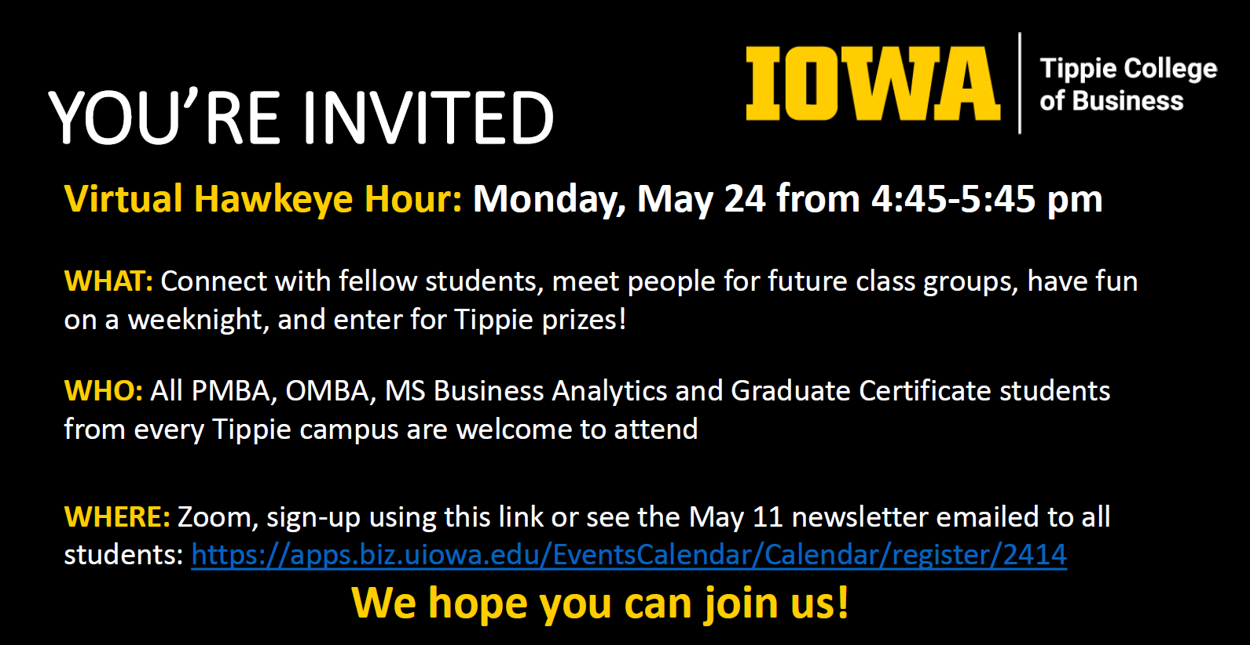
Hawkeye Hour

